Slide 1
MIGHTY CRACKER
Chris Bugg Chris Ham Jon Wright Nick Baum

Slide 2
Overview
Program to crack passwords

Slide 3



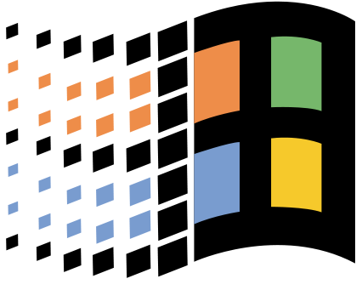

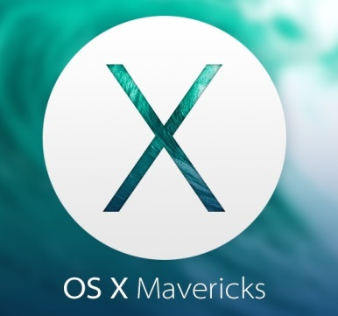
Development
Python 2.7.X
Pycharm
Linux, OSX, Windows
Git

Slide 4
Ways To Crack
Single User
Network Mode
Brute Force
Dictionary
Rainbow Table

Slide 5
Brute Force
Systematically checking all possible keys until the correct one is found.
Worst case this would transverse the entire search space

Slide 6
Dictionary Attack
Uses a prebuilt list of possible keys
Attack succeeds because many people choose a password that based on a word and 7 characters of fewer

Slide 7
Rainbow Table
More complicated way to store lots of hashes in less space.

Slide 8
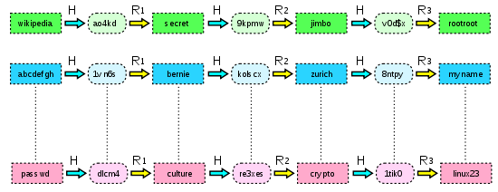
Rainbow Table

Slide 9
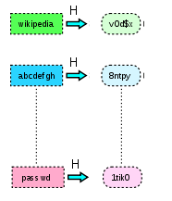
Rainbow Table

Slide 10
Single vs Networking
Single user mode only uses one computers power to crack a password. All cracking modes are available
Networking mode allows many nodes to connect to a host to increase power. All cracking modes are available

Slide 11
What is Hashing
A way to encode a password to help protect it.
MD5 Popcorn -> cf4ff726403b8a992fd43e09dd7b5717
SHA-256 Popcorn -> 951e689364c979cc3aa17e6b0022ce6e4d0e3200d1c22dd68492c172241e0623

Slide 12
Hashing Algorithms
sha 224,sha 256, sha 512, sha 1, and md5

Slide 13
GUI Demo

Slide 14
Why Python

Slide 15
Challenges

Slide 16
Other Products

Slide 17
Motivations

Slide 18
Future Plans

Slide 19
Questions?

